Slide 1
Ames Predicting Property Price
Prepared for : Management of BestEstate Co.
DSI 31’s Best Team
Notes:
Audience: Buyers and Sellers

Slide 2
Table of contents
01
03
05
02
04
06
Introduction & Problem Statement
Model Selection
Conclusion
EDA
Limitations
Recommendation
Notes:
Intro and Problem Statement: Qi Xiang
EDA: Jinru
Model Results and describe Features: Junwei
Limitations: Keith
Conclusions and recommendations: Keith

Slide 3
01
Introduction & Problem Statement

Slide 4
Introduction
BestEstate Co
Web/App usage: 5.27 session by day. 158.1 sessions by month
Web/App success: 1.27 success session by month
Web/App price prediction accuracy : Around 81%
Goal: To develop a regression model that will make accurate predictions of house prices in the city of Ames in Iowa.
Homeowners can more accurately determine the asking price at which to list their property. They won't undervalue their home in this manner and miss out on possible profit.
Vice versa, homebuyers can avoid unintentionally making overpriced purchases by knowing what is a fair price to pay for a specific house.
Notes:
Based on your last year app/web performance and customer review, we observed that web/app usage 5.27 session by day and 158.1 session by month but only 1.27 success session transaction through the web. And with a price prediction accuracy of around 81%, so today we are reaching out to you to provide you a better solution.
Clients frequently expect realtors to provide quick back-of-the-envelope estimates of market value based on experience and market transactions in this age of digitization when efficiency comes at a cost. A thorough evaluation by a valuer requires some time and is frequently completed only when the buyer is prepared to commit. The estimation then forms the foundation of the negotiation with the seller. Expectations are not met and loan approval may be impacted when the actual valuation differs from the initial estimate, potentially resulting in deal loss.
So with those in minds, we are using data science to predict the prices, so that we will be able to come up with more competitive and hopefully reasonable prices. We are also looking for important features that homeowners can look into to potentially improve the property's sales value.

Slide 5
Problem Statement
To determine the features that can be improved to drive up prices.
To pinpoint the features that have a negative impact on prices.
Notes:
Therefore, our objective is to present a model with a solution that addresses these problem statement.
To determine the features that can be improved to drive up prices.
To pinpoint the features that have a negative impact on prices.

Slide 6
02
EDA

Slide 7
Ames Housing Dataset
80 columns and over 2000 rows of different features relating to houses
Used by the Ames Assessor's Office to compute assessed values for individual residential properties sold in Ames, IA from 2006 to 2010.

Slide 8
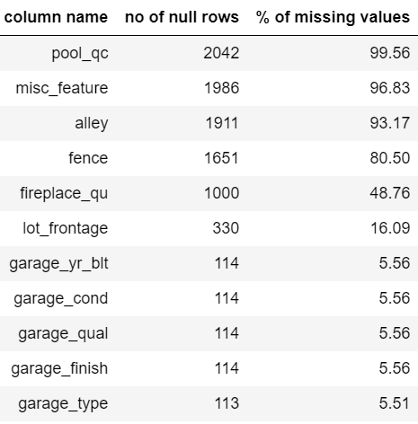
Data Cleaning for columns with >5% missing values

Slide 9
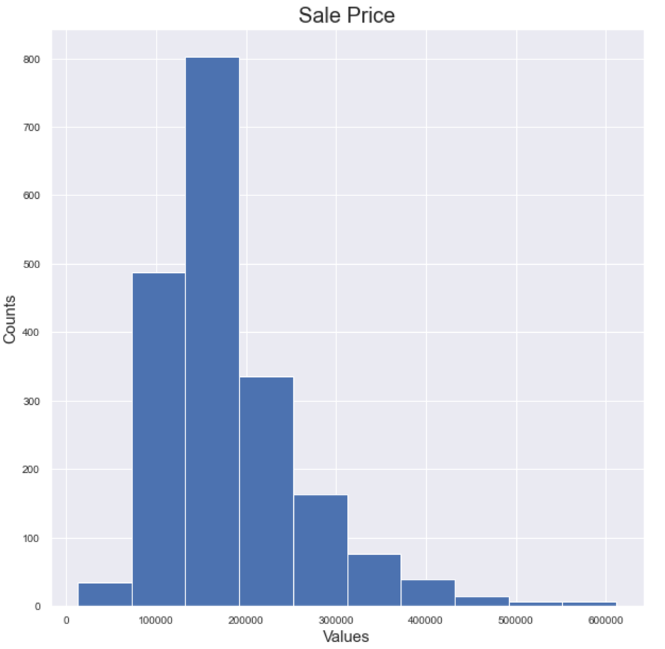
Sale Prices are mostly in the 150-200k range

Slide 10
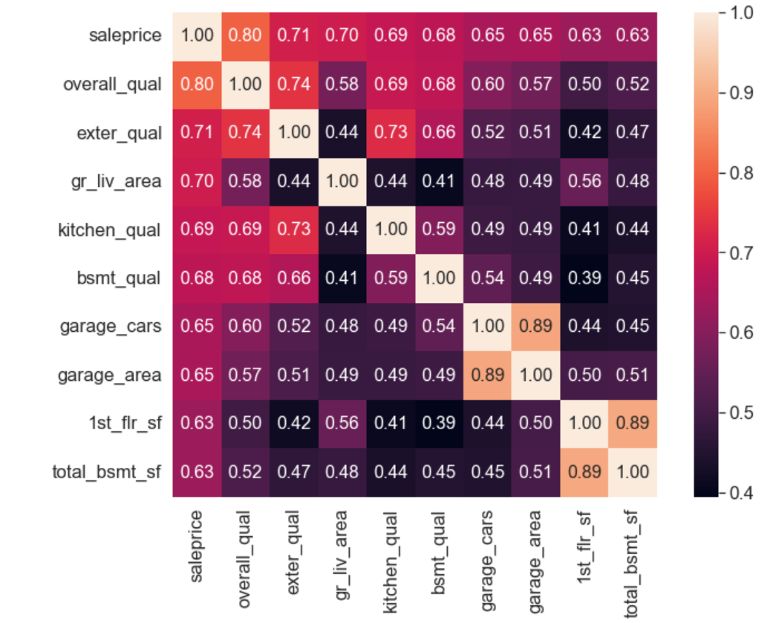
Top 10 Features correlating with Sale Price

Slide 11
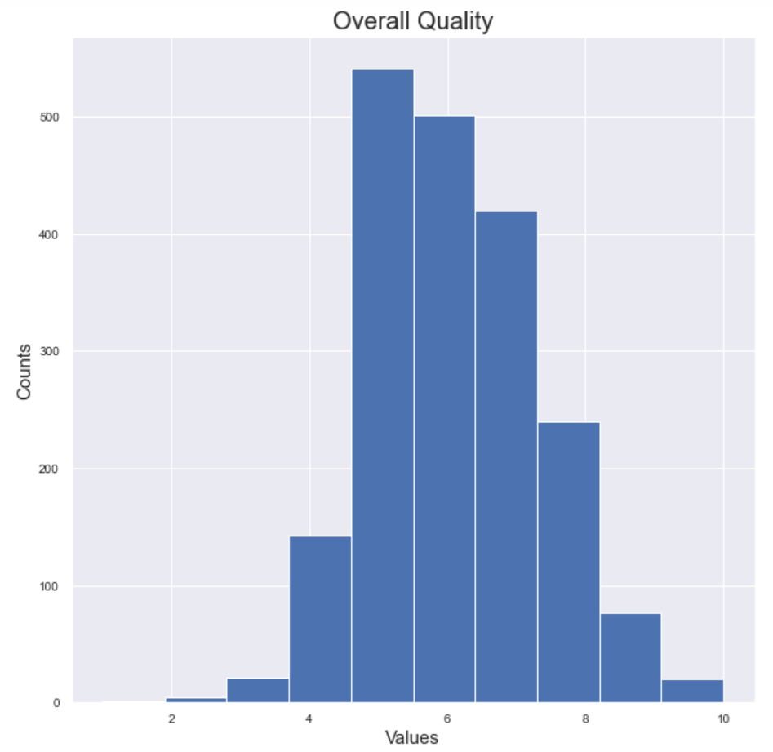
Most of Ames houses have mid-range Overall Quality score

Slide 12
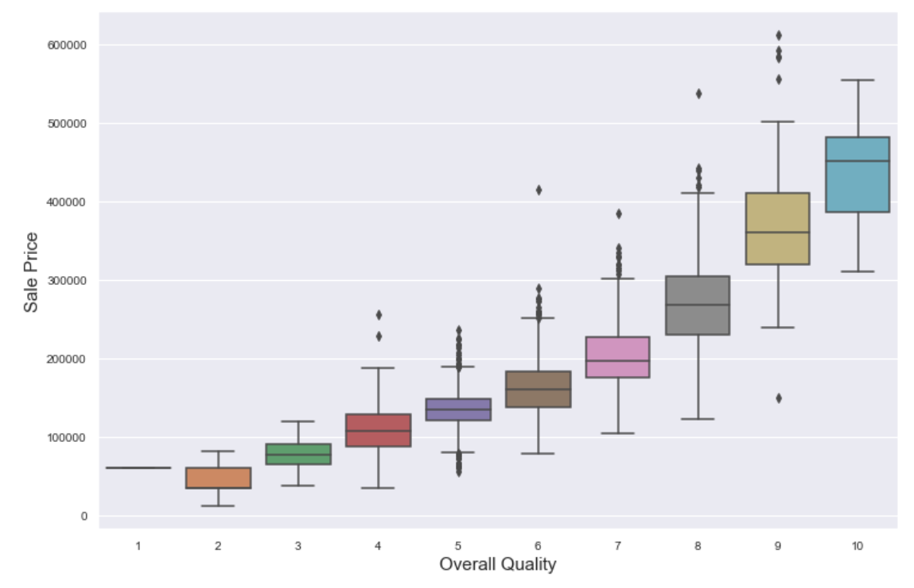
Sale Price increases with Overall Quality

Slide 13
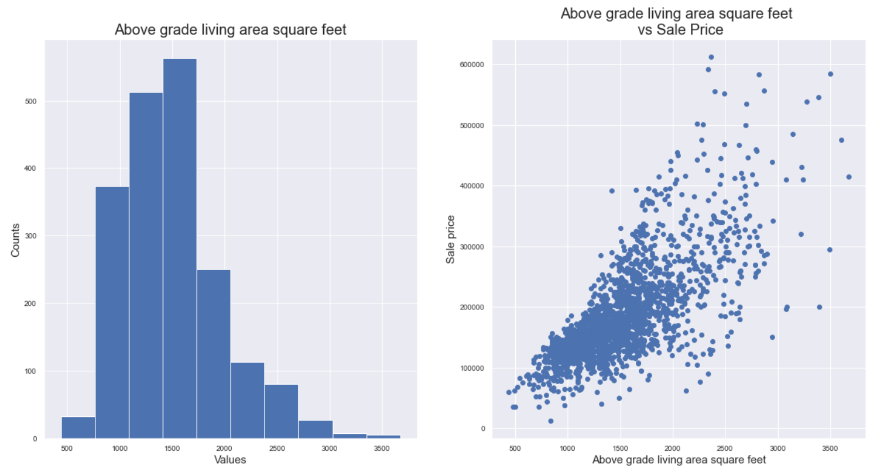
In general, Sale Price increases as Above Grade Living Area increases

Slide 14
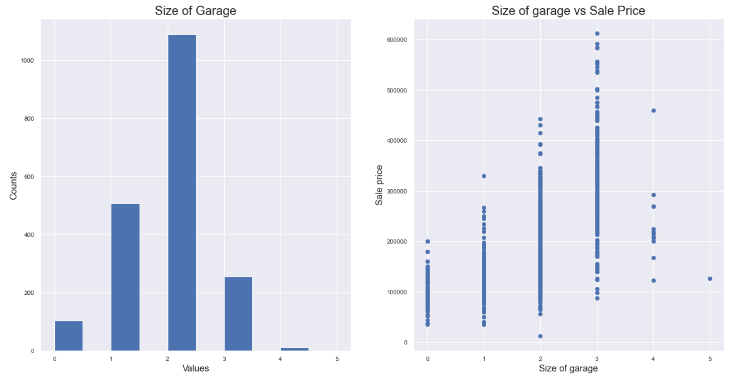
Most houses have space for 2 cars but we see higher range of sale prices for houses with 3 cars garage space.

Slide 15
03
Model Selection

Slide 16
Model Test Results
Model | Test Results
Baseline Model | -0.00115
Linear Regression | 0.89199
Ridge Regression | 0.89355
Lasso Regression | 0.89233
Ridge Regression is the best performing model!
This is in line with our understanding of machine learning models.

Slide 17
Interpretation of Model Coefficients
Positive coefficient means increase in a variable will cause the sale price to increase.
Negative coefficient means increase in a variable will then cause the sale price to decrease.
Value signifies the impact a change in a variable will have on the sale price.

Slide 18
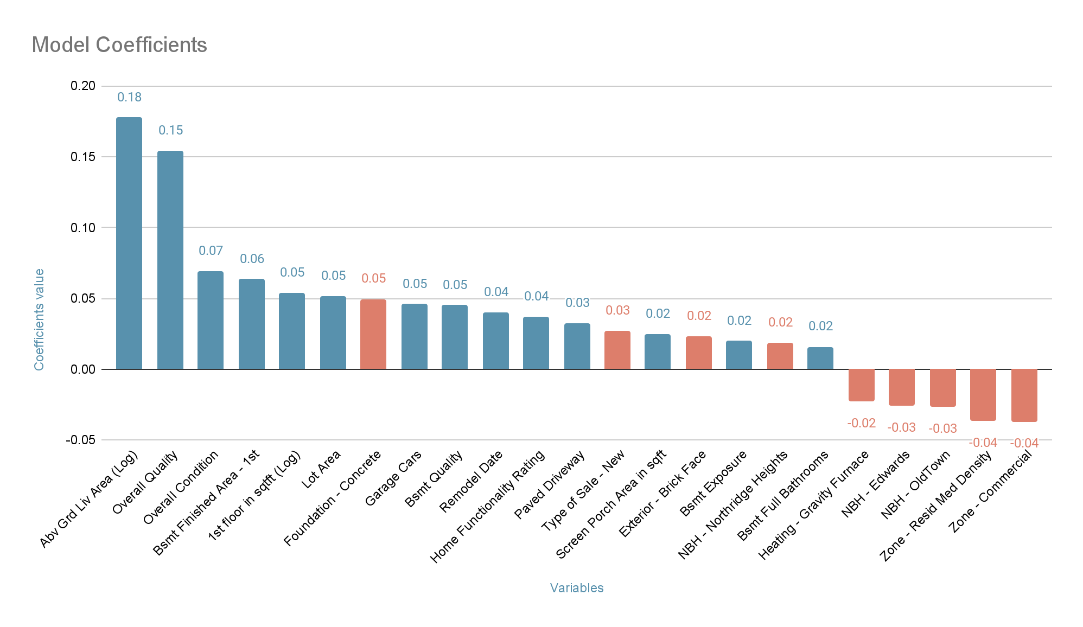

Slide 19
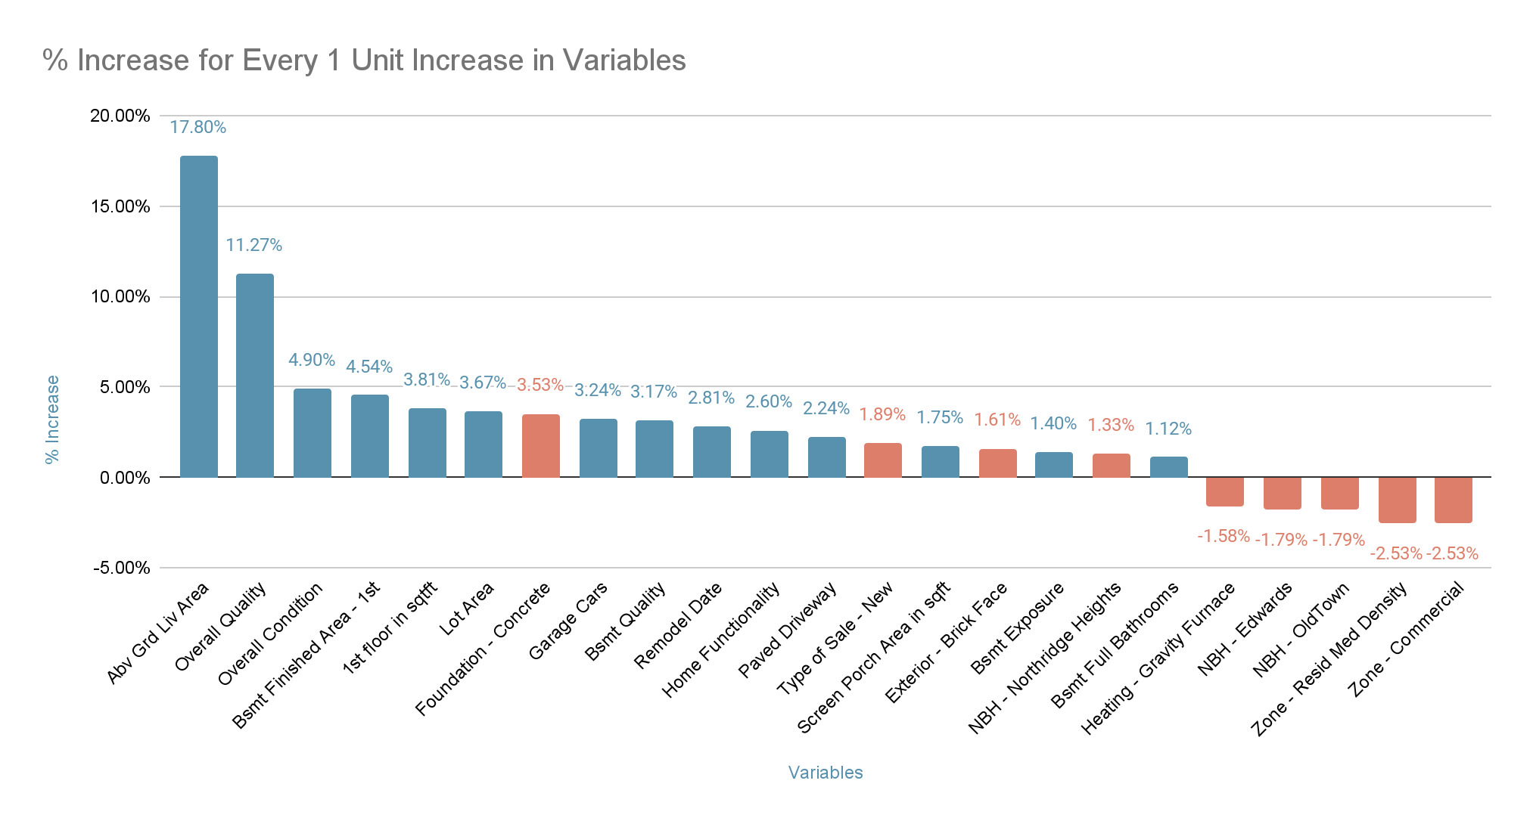

Slide 20
Interpretation of Model Coefficients
Average Sale Price = $183,000
Variable | Coefficient values | % ↑ for every 1 Unit ↑ in Variable | % ↑ in Monetary Value
Abv Grd Liv Area (Sqft) | 0.178 | 17.80% | $33,000
Overall Quality | 0.154 | 11.27% | $21,000
Overall Condition | 0.069 | 4.90% | $9,000
Zone - Resid Med Density | -0.037 | -2.53% | -$5,000
Zone - Commercial | -0.037 | -2.53% | -$5,000

Slide 21
04
Limitations & Improvements

Slide 22
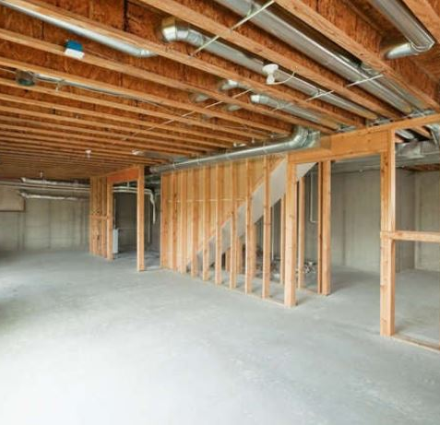
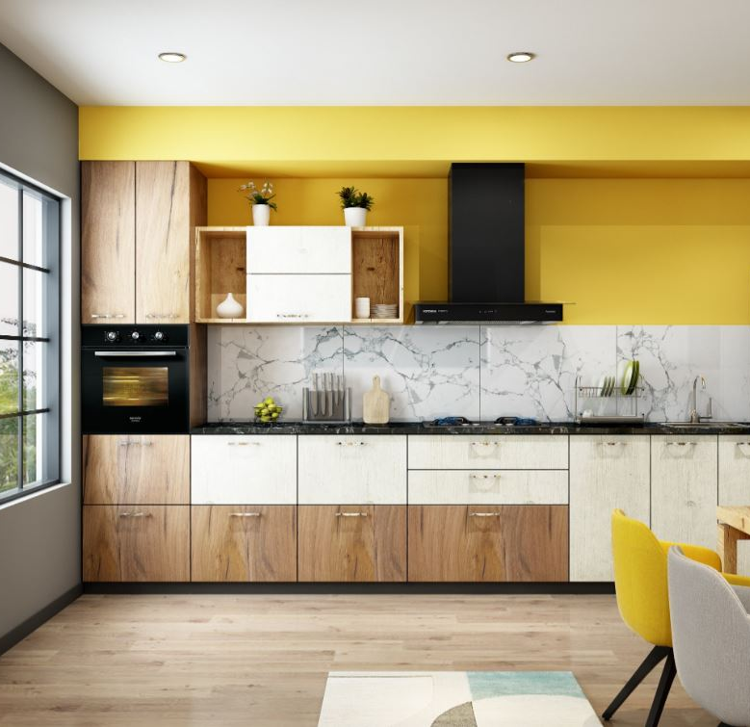
Limitations
Some inputs have unclear ratings:
Condition, quality
Excellent, Good, Average, Fair
Multicollinearity:
Corr threshold > 0.7
External Factors:
eg. black swan events
Notes:
Quality of data ~ Model performance
Model uses ordinal data: overall qual, overall condition, functional, bsmt qual
Unclearly defined ratings - Buyer/seller interpretation differs from dataset

Slide 23
Future Improvements
Uncover new valuable inputs
Test different categorical groupings
Hyperparameter Tuning

Slide 24
05
Conclusion

Slide 25
Conclusion
Based on test results,
Our model can predict 89.36% of the changes in sale prices accurately with the changes in inputs
Characteristics most impactful on sale price:
‘Above grade living area square feet’
Overall material & finish quality
Model accuracy ≈ Quality of Data

Slide 26
06
Recommendations

Slide 27
Recommendations
Value-add to current product/service offering
Buyers & Sellers should make informed decision
Utility
Investment
Valuation is only a benchmark
3 valuation methods
Sales Comparison
Cost
Income Capitalisation
“10 different valuers, 10 different valuations”
Notes:
sales comparison approach, cost approach, and income capitalization approach

